Slide 1
Igor A. Kesler
Igor A. Kesler
21.04.2011

Slide 2
Agenda
Use cases requirements analysis
Application architecture
Database architecture
Desktop calculator
Readability test application

Slide 3
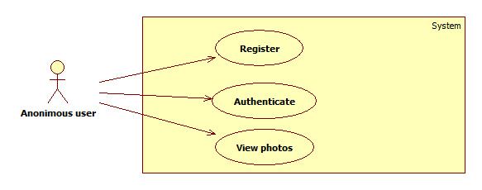
Use Cases - Guest

Slide 4
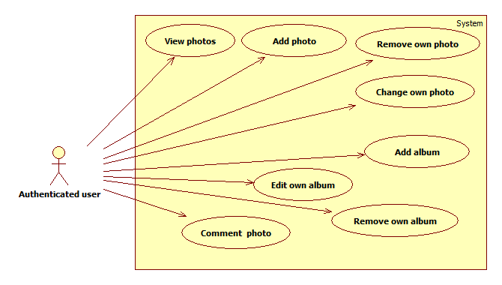
Use Cases - Author

Slide 5
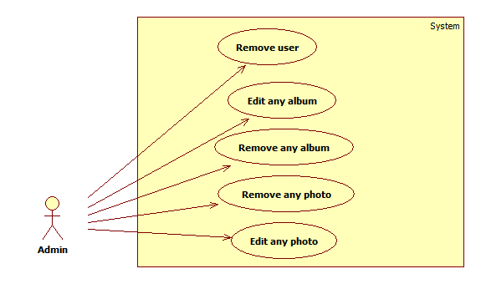
Use Cases - Admin

Slide 6
Application Architecture

Slide 7
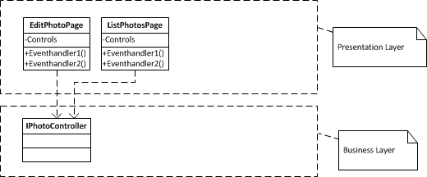
Architecture – Presentation Layer

Slide 8
Architecture – Business Layer

Slide 9
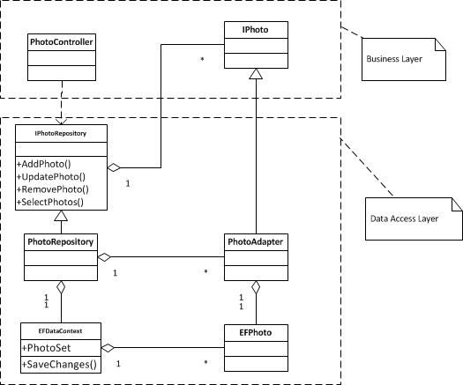
Architecture – Data Access Layer

Slide 10
Problems and solutions
High coupling with Entity Framework. Pattern Adapter.
High coupling between Layers. Inversion of control.
System events handling. Pattern Controller.

Slide 11

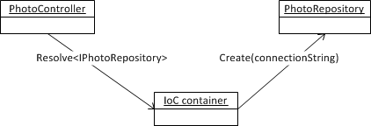
Inversion of control
Direct control – high coupling between components
Inversion of control – low coupling through contracts
Resolving of contract
Dependency injection

Slide 12
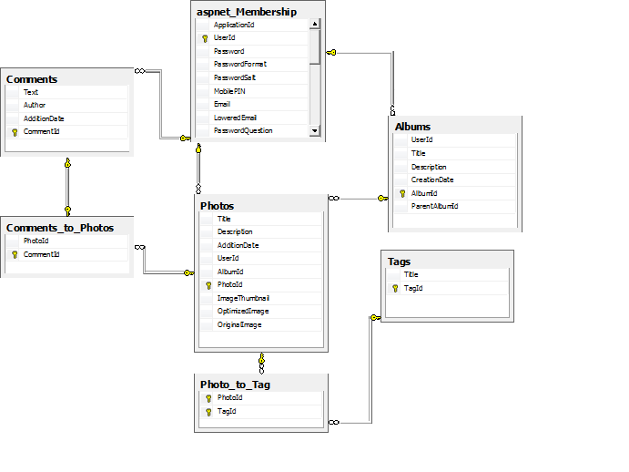
Database model

Slide 13
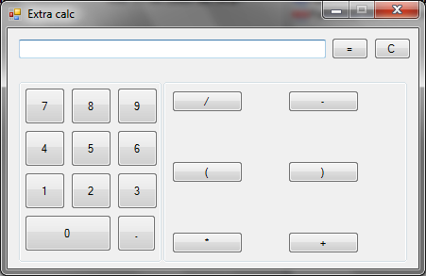
Calculator
Widows Forms GUI
Plugins API via reflection

Slide 14

Readability test
GUI is not blocked until text is processed
Stop, Pause, Resume are supported

Slide 15
Summary
UML modeling
Three-tier architecture
Entity-relationship database modeling
ASP.NET Web Forms framework
Windows Forms framework

Slide 16
Contacts
Europe Headquarters
52 V. Velykoho Str.
Lviv 79053, Ukraine
Tel: +380-32-240-9090 Fax: +380-32-240-9080
E-mail: info@softserveinc.com
Website: www.softserveinc.com
US Headquarters
12800 University Drive, Suite 250 Fort Myers, FL 33907, USA
Tel: 239-690-3111 Fax: 239-690-3116
Thank You!
Copyright © 2011 SoftServe, Inc.

